Slide 1
CoCoNet: an efficient deep learning tool for viral metagenome binning
Ce´ dric G. Arisdakessian, Olivia D. Nigro, Grieg F. Steward, Guylaine Poisson and Mahdi Belcaid

Slide 2
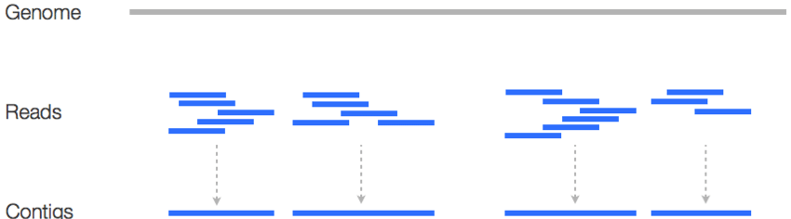
Metagenomic Assembly
The process of assembling DNA sequences from short reads taken from environmental samples. The ends of the reads are overlapped to assemble a sequence, a contig.
Shotgun assembly is where DNA has reads of random length and location generated multiple times, and the contig is assembled using all reads from each iteration.

Slide 3
Binning Contigs
Metagenomic binning is the process of assigning contigs to a particular genome.
If reference genome sequences are present, binning is straightforward. Contigs can be compared to the reference sequence.
For contigs where the species providing the sample does not have a reference genome, binning becomes much more complicated.
For viral metagenomic binning, the problem is even harder. Viral metagenomic assembly often produces short contigs, witch makes clustering harder.

Slide 4
Methods of Binning Contigs
There are three broad classes of algorithms for binning contigs:
Methods based on sequence composition look at k-mers and bins contigs with similar distributions. This method struggles with similar species.
Methods based on sequence coverage correlation look at the number of reads in each contig and how similar the coverage values are. This method works best with plenty of samples.
Methods that are a combination of the other two. These tend to have the advantages of both while mitigating many of the disadvantages, but are computationally complex.

Slide 5
Composition and Coverage Network (CoCoNet)
A neural network learns to predict the probability that a pair of contigs came from the same genome.
The predicted probabilities are then used to infer bins for the genomes of the species in the samples, alongside composition and coverage information. This step is a heuristic that is traceable.
This model was optimized to work with a large diversity of species, such as those found in environmental samples.

Slide 6
Simulated Dataset
The reference genomes are from the NCBI RefSeq viral database. The dataset has genomes from 13,274 viruses. 9,316 of the genomes are over 3 kb.
The dataset was first converted from IUPAC to A, C, G, T. Unresolved nucleotides were removed from k-mer counts to remove bias. Genomes under 3kb were discarded.

Slide 7
Simulated Dataset (Cont.)
CAMISM was used to preprocess the dataset so that four metagenomes were simulated. Each simulated metagenome had either 4 or 10 samples and converge to either 3x or 10x. Each combination of conditions was repeated 10 times for 80 simulations.
For each simulation, either 500 or 2,000 genomes were sampled and a log-normal distribution was used to create relative abundances.
Sequencing was simulated by splitting each genome into sections with an average length of 400 bp and a standard deviation of 10 bp. This was used to simulate paired-end reads.

Slide 8
Experimental Dataset
The experimental dataset is from Beaulaurier et al., and is collected from Station ALOHA. It contains three viral metagenomes from the North Pacific Subtropical Gyre. Raw Illumina reads were downloaded from SRA and trimmed with Fastp.
Reads were assembled with MetaSPAdes and produced 59,027 contigs over 2048 bp. Reads were then filtered through several steps to improve the quality of the genomes, resulting in 1,322 unique contigs (2.24%).

Slide 9
Experimental Dataset: Removed Contigs
Reads were aligned with the contigs using the bwa-mem algorithm.
Pysam was used to drop:
Partial alignments
Low quality alignments
Alignments containing an unmapped mate-pair
Reads with multiple alignments or duplicates were dropped.
Paired alignments with less than 200 or over 500 bp distances were dropped.
Draft genomes were assembled using ONT reads, then the contigs were depreciated using Cluster-Genomes.

Slide 10
Data Preprocessing
Contigs longer than 2048 base pairs (bp) were divided into 1024 bp fragments. (step: 128 bp)
The composition feature is calculated by summing the occurrences of each k-mer for both the forward and reverse strands, where k = 4. This makes the k-mer distribution direction-invariant. 136 k-mers were collected.
The coverage feature is the count of each raw reads aligning at each position of a fragment. Partial reads (50% or less of the query’s length), reads with a quality score under 30, and reads with more than one high-quality alignment are removed to reduce errors based on mis-assembly.
Contigs with only one occurrence were removed as co-occurrence information does not exist for lone samples.

Slide 11
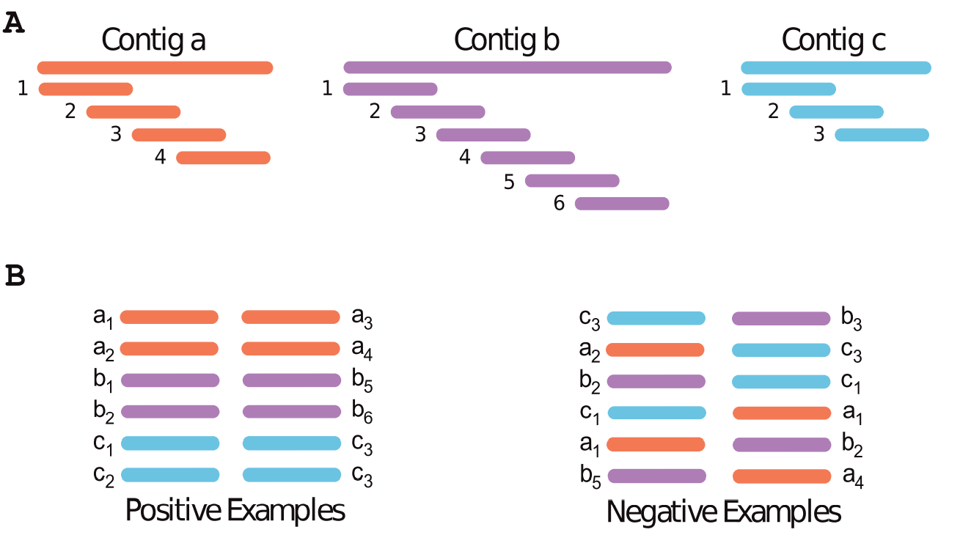
Dataset Splitting
There was an initial 90/10 train/test split. Both sets contained positive (from the same contig) and negative (from different contig) examples.
The distance between the positive examples was maximized to avoid examples were the fragments overlapped.
The same number of positive examples were generated from each contig in an attempt to avoid bias towards long contigs.
The negative examples are generated randomly.

Slide 12
Neural Network
Both composition vectors (forwards and backwards) are processed by 64-neuron dense layers that share weights. The element-wise maximum is returned for each neuron.
At the same time, the coverage vectors are processed with two 1D convolution layers (filters=16, kernel_size=4, stride=2) followed by 32-neuron dense layers. These layer pairs share weights as well.
Each network has its output aggregated into 64-feature vectors. This is followed by a Siamese network in order to make the output invariant of input direction.
The final step is separate dense layers that predict composition, coverage, and combined probabilities.

Slide 13
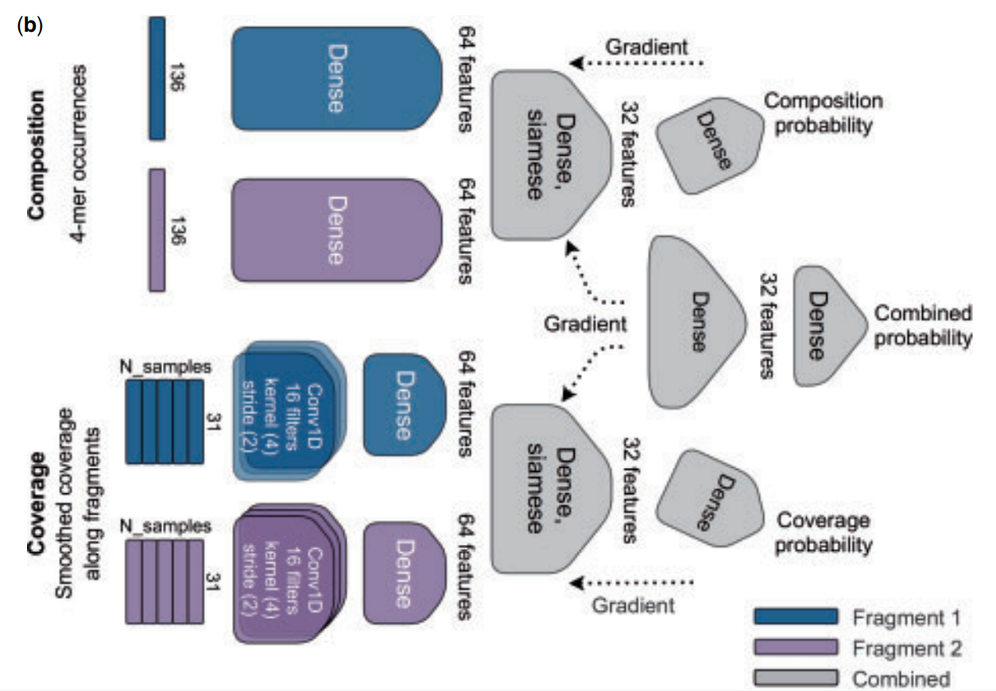
Neural Network (Cont.)

Slide 14
Clustering
Clustering is done using a clustering graph, where nodes represent contigs and edges represent contigs belonging to the same bin.
Edges are computed by splitting each counting into 30 fragments of 1024 bs that are regularly spaced and maximally distant. The probabilities that any fragment of one contig overlaps with another is computed, and all of the probabilities are summed. If this scores is over a threshold (default 80%), then it is counted as an edge.
The Leiden algorithm was used to identify the bins in the graph representing species.

Slide 15
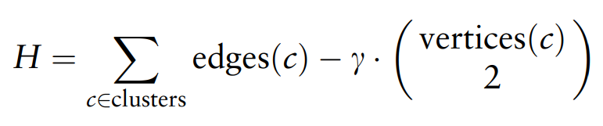
Leiden Algorithm
The Leiden algorithm optimizes the Constant Potts Model (CPM) in order to infer clusters.
where edges() and vertices() are counts, and 𝛾 controls how dense clusters are in terms of edges.
Initially each edges is its own bin. Iteratively the algorithm improves H by moving between nodes, then refines the clusters into sub-communities, then aggregates the edges of a cluster into an aggregated network. The iteration stops when H cannot improve.

Slide 16
Leiden Algorithm Modifications
To account for potential missing edges (not all possible edges are computed), clustering is performed in two stages.
Stage 1 is run with 𝛾 = 0.3 to find initial clusters.
Stage 2 is run within each cluster to fill the adjacency matrix and look at the remaining comparisons. This is done with 𝛾 = 0.4.

Slide 17


Metrics
The NN was evaluated with ROC AUC and F1 scores. The clustering bins were evaluated with the following:
Adjusted Rand Index (ARI): The ratio of all pairs assigned correctly among all possible pairs.
Homogeneity: Measures if the clusters contain only a single class (true negatives).
Completeness: Measures if all members of a given class are in the same cluster (true positives).

Slide 18
Results: Alternate Algorithms
CoCoNet is compared to two other algorithms, CONCOCT and Metabat2.

Slide 19
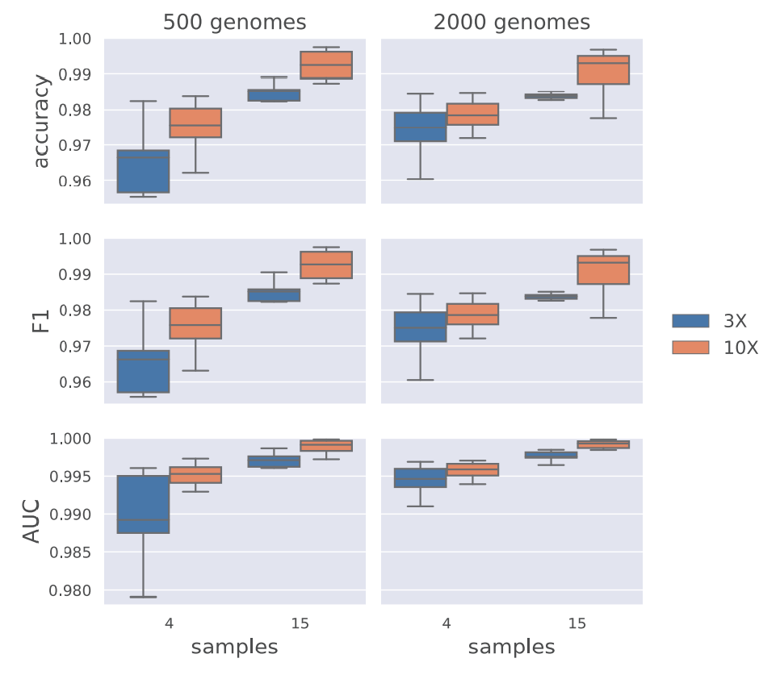
Results: Simulated Data: Neural Network
The network was trained on 4-mer frequencies and coverage vectors.
The authors postulate that the increased number of species genomes leads to better scores with lower variance because the increased variety in samples invites generalization.

Slide 20
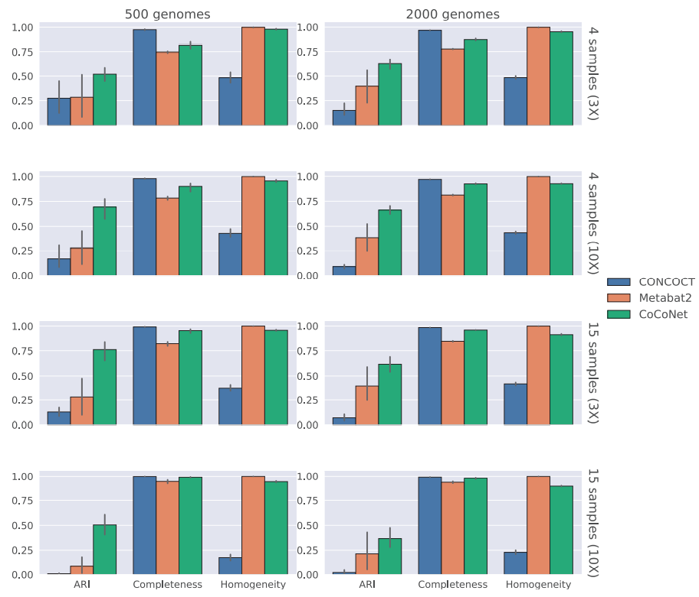
Results: Simulated Data: Binning
CoCoNet has an accurate reconstruction rate of 14% for bins with at least two contigs. Metabat2 and CONCOCT averaged 2.1% and 2.0%, respectively.
CoCoNet yielded more bins with contigs from the same genome and fewer bins with contigs from different genomes than the other algorithms.

Slide 21
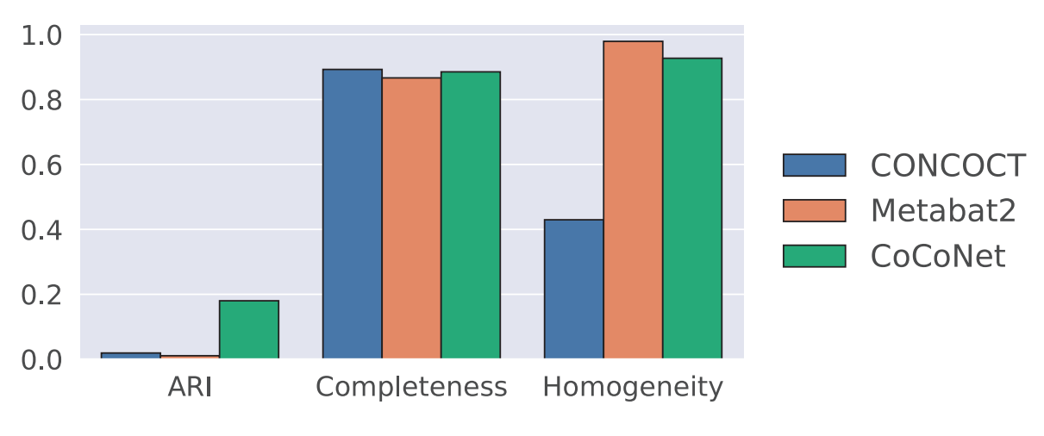
Results: Experimental Data

Slide 22
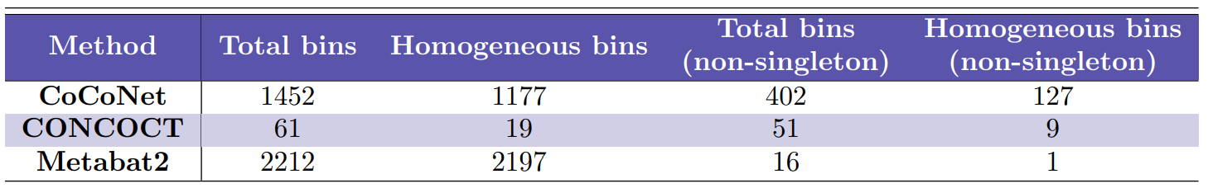
Results: Experimental Data (Cont.)
CoCoNet has a significantly higher percentage of homogenous bins than CONCOCT, but is outperformed by Metabat2 (81.1%, 31.%, and 99.3% respectively).
However, CoCoNet massively outperforms CONCOCT and Metabat2 in the non-singleton bin identification (31.6%, 17.6%, 6.3% respectively).

Slide 23
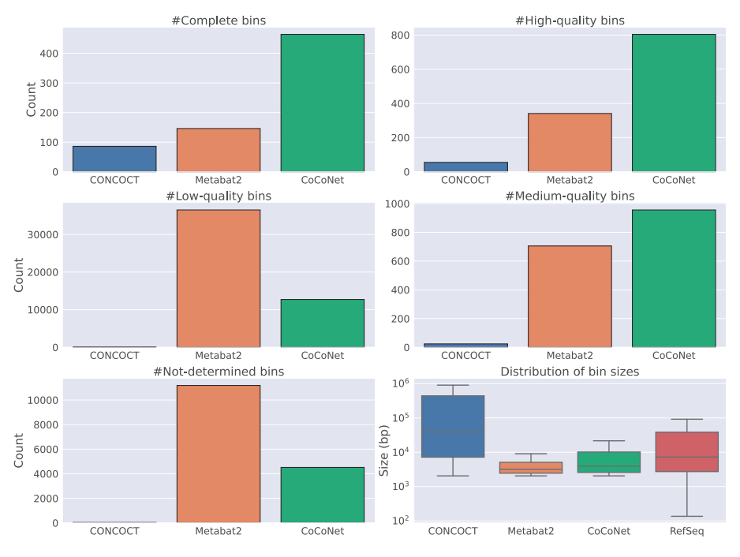
Results: Experimental Data (Cont.)
CheckV is used to classify bins into 5 different quality categories.
The results mirror the ARI scores.

Slide 24
Discussion
CoCoNet’s approach to clustering focuses on bin homogeneity. This can be adjusted by changing the fragment length, minimum number of matches between contigs connected by an edge in the graph (𝜃), and the minimum edge density for considering a cluster as a bin (𝛾).
Decreasing these values decreases bin stringency, allowing more populated bin with the consequence of more mis-binned contigs.

Slide 25
Discussion (Cont.)
CoCoNet substantially outperforms the other algorithms for viral metagenome binning by finding more correct bins with fewer errors than either of the other algorithms. This is particularly impressive as the experimental dataset only had three species samples, causing lower diversity in the dataset.
The authors propose that their choice of using a sliding window to evaluate the coverage scores instead of a summary statistic as both an unusual feature in binning algorithms and as one of the main reasons that their model outperforms its competitors.

Slide 26
References
Arisdakessian, C. G., Nigro, O. D., Steward, G. F., Poisson, G., & Belcaid, M. (2021). CoCoNet: an efficient deep learning tool for viral metagenome binning. Bioinformatics, 37(18), 2803-2810.
Beaulaurier, J., Luo, E., Eppley, J. M., Den Uyl, P., Dai, X., Burger, A., ... & DeLong, E. F. (2020). Assembly-free single-molecule sequencing recovers complete virus genomes from natural microbial communities. Genome Research, 30(3), 437-446.
Benhur, S. (2022, January 25). A Friendly Introduction to Siamese Networks. Built In. https://builtin.com/machine-learning/siamese-network
Contig. (n.d.). Genome.gov. https://www.genome.gov/genetics-glossary/Contig
Olson, N. D., Treangen, T. J., Hill, C. M., Cepeda-Espinoza, V., Ghurye, J., Koren, S., & Pop, M. (2019). Metagenomic assembly through the lens of validation: recent advances in assessing and improving the quality of genomes assembled from metagenomes. Briefings in bioinformatics, 20(4), 1140-1150.
Wikipedia contributors. (2022, November 15). Binning (metagenomics). Wikipedia. https://en.wikipedia.org/wiki/Binning_(metagenomics)
Wikipedia contributors. (2022b, November 17). Shotgun sequencing. Wikipedia. https://en.wikipedia.org/wiki/Shotgun_sequencing
Xu, S., Stolarek, I., Farman, M., & Thind, A. (2020, March 22). What is the principle of transcriptome assembly after RNA-seq? ResearchGate. https://www.researchgate.net/post/What-is-the-principle-of-transcriptome-assembly-after-RNA-seq

